Slide 1
Introduction to Data Analytics
IBM Data Analyst Course: Course One, Week Three

Slide 2
AGENDA
Gathering Data
Wrangling Data

Slide 3
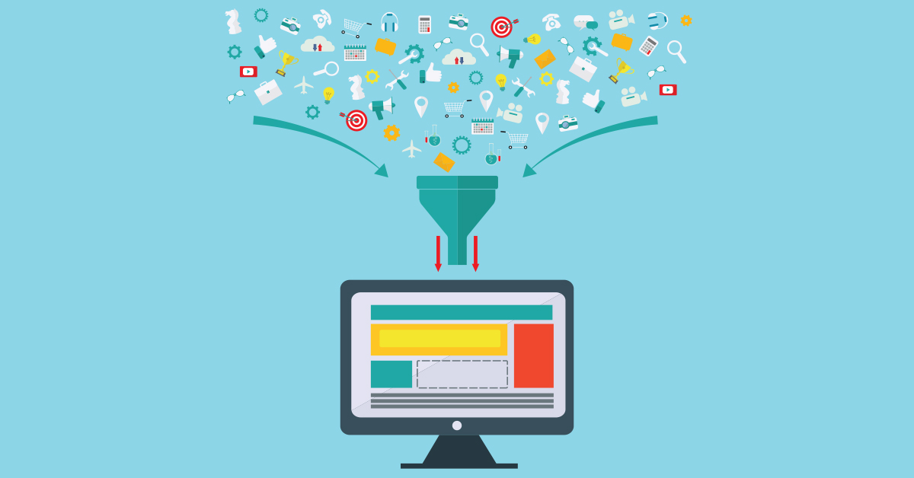
GATHERING DATA

Slide 4
PROCESS FOR IDENTIFYING DATA
Determine the information you want to collect
Define a plan for collecting data
Determine your data collection methods
Notes:
1. The first thing you need to do is choose what details you want to collect. You’ll need to decide what topics the information will cover, who you want to collect it from and how much data you need. Your goals — what you hope to accomplish using your data — will determine your answers to these questions. As an example, you may decide to collect data about which type of articles are most popular on your website among visitors who are between the ages of 18 and 34. You might also choose to gather information about the average age of all of the customers who bought a product from your company within the last month.
2. Next, you can start formulating your plan for how you’ll collect your data. In the early stages of your planning process, you should establish a timeframe for your data collection. You may want to gather some types of data continuously. When it comes to transactional data and website visitor data, for example, you may want to set up a method for tracking that data over the long term. If you’re tracking data for a specific campaign, however, you’ll track it over a defined period. In these instances, you’ll have a schedule for when you’ll start and end your data collection.
The next is to decide how much data we need. We want to get enough data so what we can see patterns and trends. For each data element on the list, write down how much data is actually needed.
3) To determine data collection methods

Slide 5
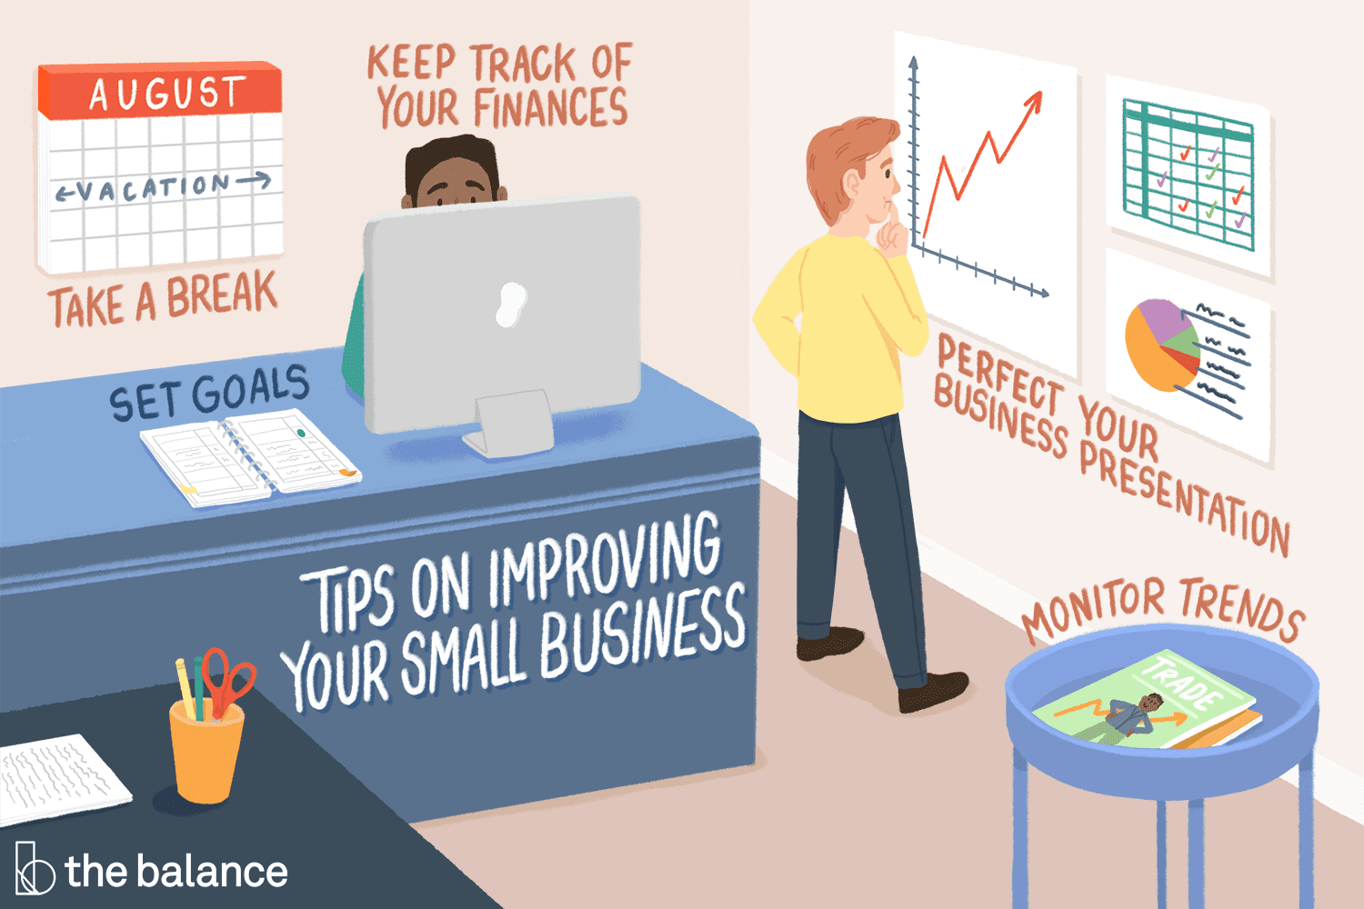
Determine the information you want to collect
Specific information
Sources of this data

Slide 6
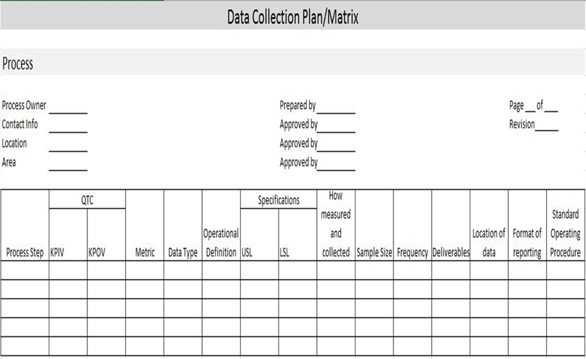
Define a plan for collecting data
Establish a timeframe
How much data is sufficient for credible analysis?
Define dependencies, risk and mitigation plan
Notes:
You can prepare a checklist for creating a plan and see how you wish to collect the required data.

Slide 7
Determine your data collection methods
The methods of data collection depends upon a number of factors:
Source of Data
Type of Data
Timeframe over which you need data
Volume of Data
Degree of accuracy required
Funds
Notes:
Data collection method depends on various factors
Type of data can be quantitative and qualitative.
Quantitative data comes in the form of numbers, quantities and values. It describes things in concrete and easily measurable terms. Examples include the number of customers who bought a given product, the rating a customer gave a product out of five stars and the amount of time a visitor spent on your website.
Because quantitative data is numeric and measurable, it lends itself well to analytics. When you analyze quantitative data, you may uncover insights that can help you better understand your audience. Because this kind of data deals with numbers, it is very objective and has a reputation for reliability.
In the early stages of your planning process, you should establish a timeframe for your data collection. You may want to gather some types of data continuously. When it comes to transactional data and website visitor data, for example, you may want to set up a method for tracking that data over the long term. If you’re tracking data for a specific campaign, however, you’ll track it over a defined period. In these instances, you’ll have a schedule for when you’ll start and end your data collection.Other factors such as source of data, type of data, timeframe over which you need data and volume of data.

Slide 8
Key Consideration while collecting data
The data you identify , the source of that data and the practices you employ for gathering the data have implications for
Security
Privacy
Quality
In order for data to be reliable , it should be free of errors, complete, consistent, relevant and accessible.

Slide 9
Data Sources
Primary
Secondary
Third Party

Slide 10
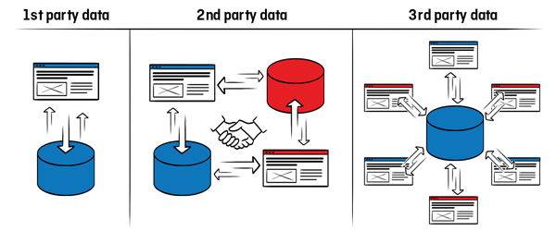
Primary data refers to information obtained directly from the source. Data from organization’s CRM, HR or workflow applications. This can be obtained directly from surveys, focus groups , interviews or questionnaires
Secondary data refers to the information obtained from existing sources such as external databases, research articles, training material . This can also be obtained directly from surveys, focus groups , interviews or questionnaires .
Third party refers to data which is purchased from aggregators who collect data from various sources and combine it into comprehensive datasets.

Slide 11
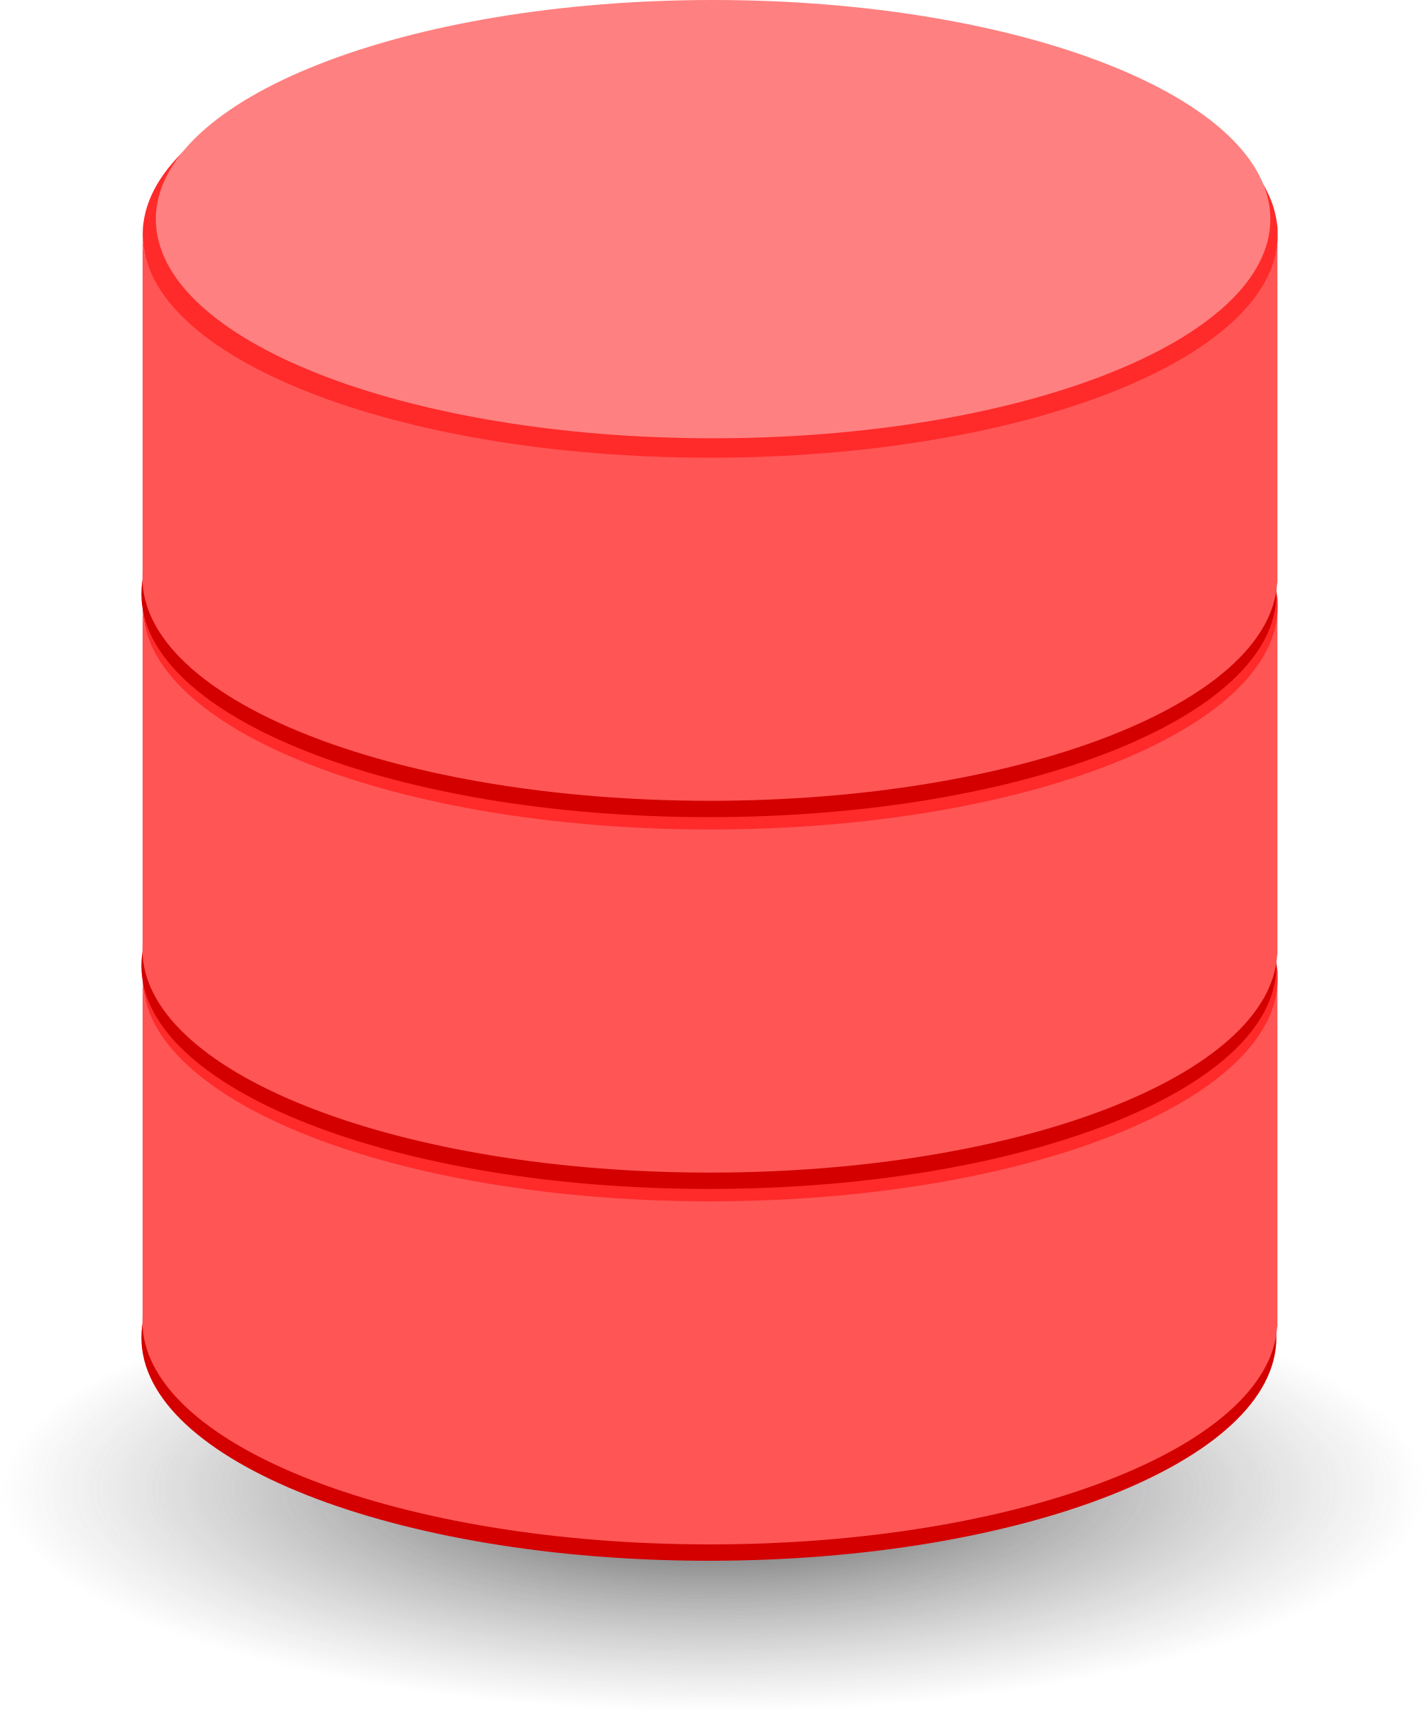




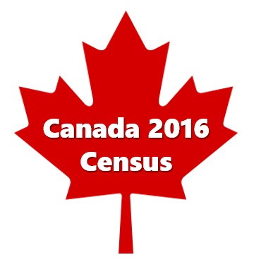


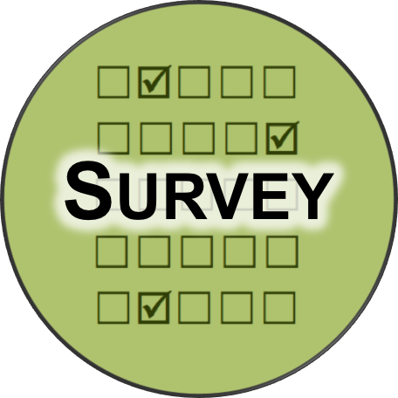
Sources for gathering data Some of the data sources from which you could be gathering data include databases, the web, social media, interactive platforms, sensor devices, data exchanges, surveys and observation studies.
Databases

Slide 12
ACTIVITY
Suggest a correct source of gathering data for below specified scenarios:
Scenario 1:
A marketing company is interested in the proportion of people who will buy a particular product.
Scenario 2:
A Community College instructor is interested in the mean number of days math students are absent from class during a quarter.
Scenario 3:
John requires an information about mechanical, orderly tasks, like checking the number of manual interventions required in a day to keep an assembly line functioning smoothly.
Scenario 4:
Sneha wants to launch her online store. She wants to run a quick analysis through which she can decide on the type of online purchases made by users frequently.

Slide 13
How to gather and import data?
SQL Queries
API
Web Scraping / Web Harvesting
Data Streams
Data exchanges
Other
Notes:
SQL Queries: The data collected is used to generate reports giving us very readable and useful insights to our servers
API: Weather Snippets. Google utilizes APIs to display relevant data from user search queries. ...
Web Scraping: General Web Scraping, for example, extracting stock prices or customer reviews.
Sensors: Ingestible sensors are an emerging technology in medical diagnosis. Unlike conformable sensors which are in contact with the skin, ingestible sensors are swallowed and stay inside the body. Ingestible sensors collect data from sensors and transmit it through wireless communication. A qualified medical practitioner can analyze this real-time data and can recommend personalized medication to the patient.
Data Exchanges:

Slide 14
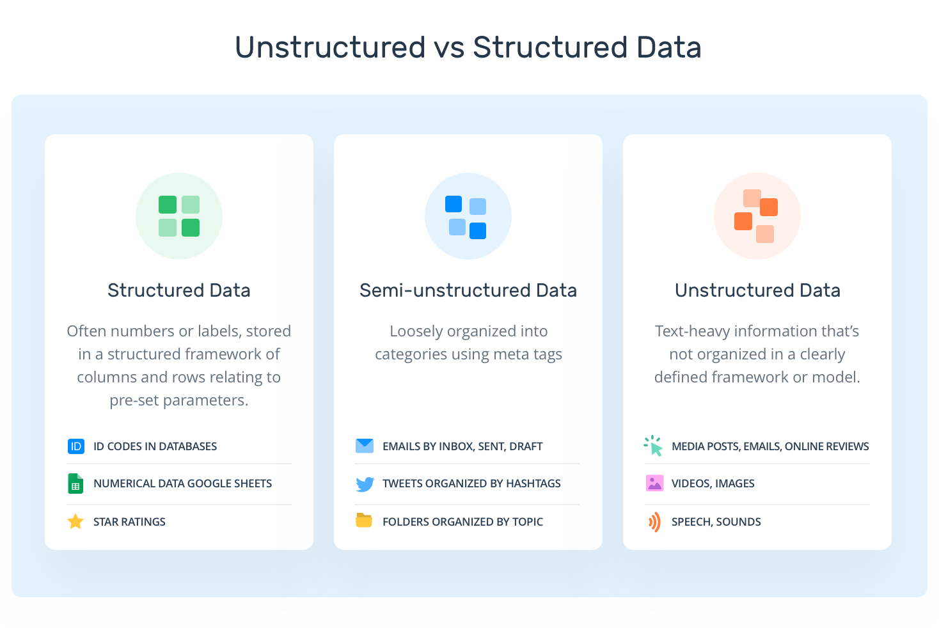
Import Data
Structured data can be stored in relational databases with well defines schemas
Semi Structured data can be stored in noSQL clusters
Unstructured data can be stored in noSQL databases or datalakes.

Slide 15
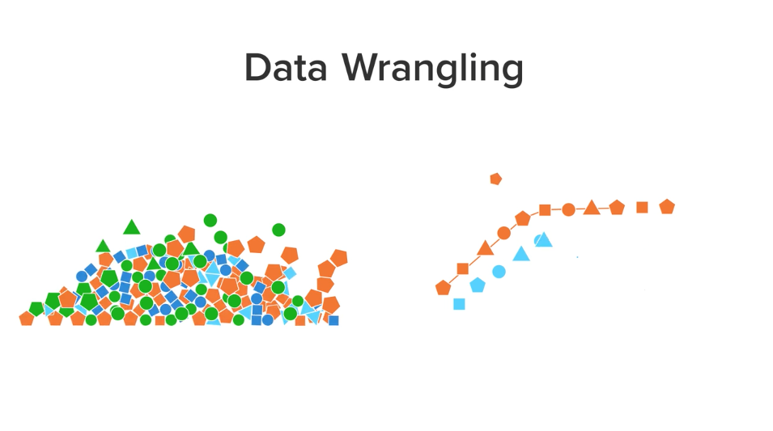
DATA WRANGLING

Slide 16
What is Data Wrangling?
Data wrangling, sometimes referred to as data munging, is the process of transforming and mapping data from one "raw” data form into another format with the intent of making it more appropriate and valuable for a variety of downstream purposes such as analytics. The goal of data wrangling is to assure quality and useful data.
It is a 4-step process that involves—Discovery, Transformation, Validation, and Publishing.

Slide 17
The Data Wrangling Process
Discovery
1
Transformation
2
Validation
3
Publishing
4

Slide 18

Discovery
The Discovery phase, also known as the Exploration phase, is about understanding your data better with respect to your use case.
Creating a plan for cleaning, structuring, organizing and mapping your data.

Slide 19

Transformation
Transformation phase, forms the bulk of the data wrangling process. It involves the task to transform the data, such as
structuring,
normalizing, de normalizing,
cleaning, and
enriching data.

Slide 20
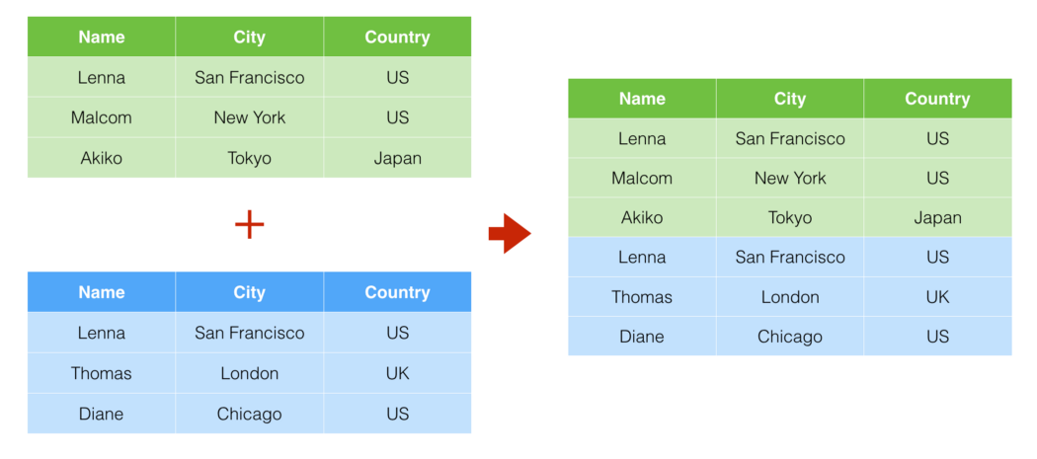
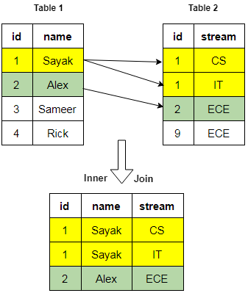
Structuring the data
Structuring refers to actions that change the form or schema of your data. Splitting columns, pivoting rows and deleting fields are all forms of structuring.
Join and Union are most common structural transformation to combine data from one or more tables.
JOIN
UNION

Slide 21

Normalizing and De normalizing Data
Normalization, from a statistical view, often has to do with calculating new values from a dataset to standardize the data on a particular scale.
It can also imply how well the transaction data is handled for reducing redundancy and inconsistency.

Slide 22
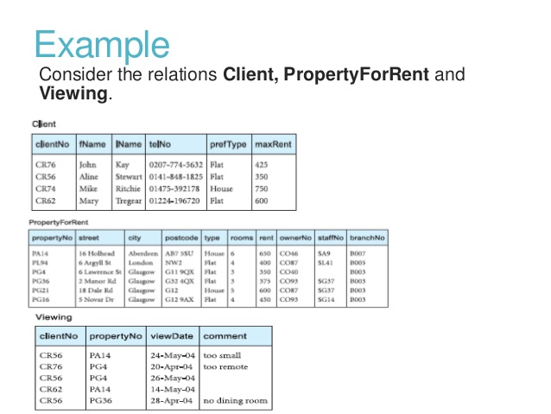
DENORMALIZATION
Combining data from multiple tables for faster querying of data for reports and analysis

Slide 23
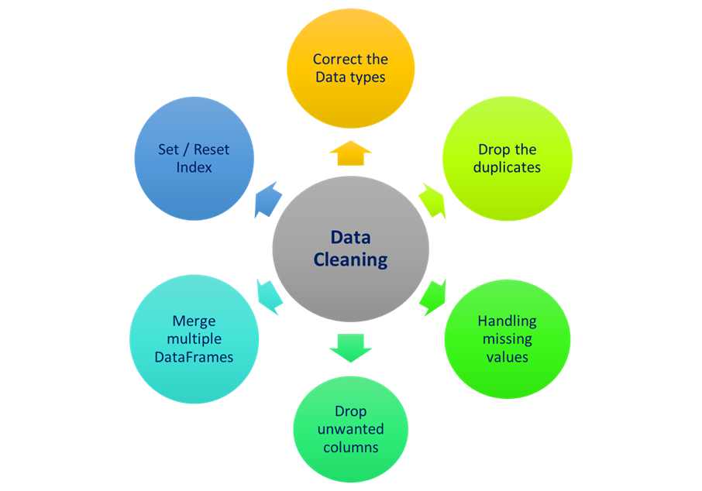
Cleaning data
During the cleaning stage, users identify data quality issues, such as missing or mismatched values, and apply the appropriate transformation to correct or delete these values from the dataset.
Example: In this dataset, if the data has also some negative values in time column, Given that it’s impossible for a time to be negative, we will simply remove those rows since they seem to represent errors in the dataset and might throw off our analysis.

Slide 24
Data Cleaning
Data cleaning is the process of ensuring data is correct, consistent and usable
Missing data can reduce statistical power
Data inconsistency creates unreliable data
Removing duplicate and inaccurate data from databases can help business save valuable resources
Incorrect data may lead to bad decisions

Slide 25
Data cleaning Workflow
The workflow is a sequence of three steps aiming at producing high-quality data and taking into account all the criteria we’ve talked about.
Inspection: Detect unexpected, incorrect, and inconsistent data. Fix or remove the anomalies discovered. Verifying: After cleaning, the results are inspected to verify correctness
Data profiling is the process of reviewing source data, understanding structure, content and interrelationships, and identifying potential for data projects..
Verification: After cleaning, the results are inspected to verify correctness.

Slide 26
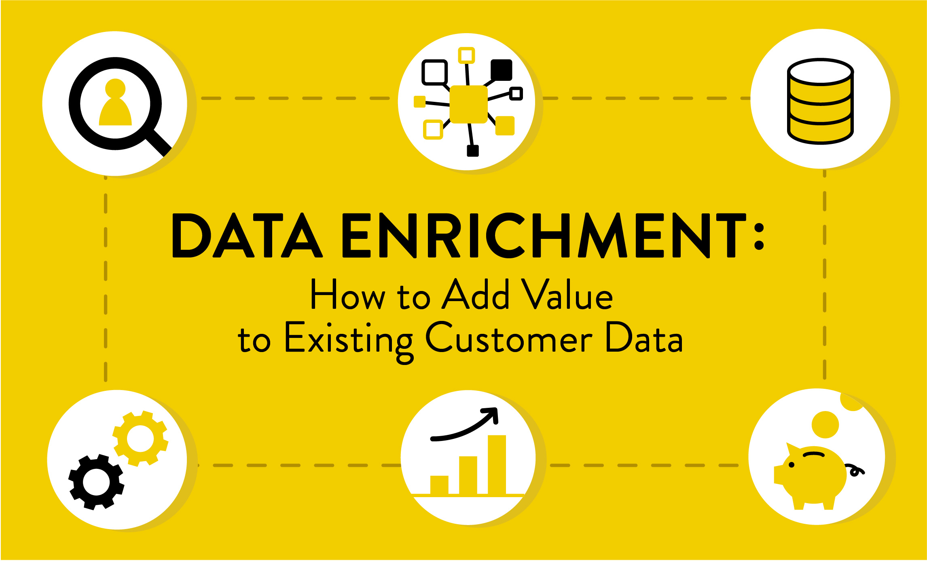
Data Enrichment
Lets take an example here:
Weather can be an important factor in outdoor trips, as it is much less appealing to ride a bicycle on a particularly rainy or windy day.
An analyst might be able to get further insights and draw more well-informed conclusions if you added weather data to the Trip dataset.
To accomplish this, you can use the join function to bring these two datasets together. After loading the Weather data you can see that it is already quite clean and standardized. Next, hitting the join function will allow you to select the Trip dataset that you’ve already cleaned.
You want to join the two datasets using the date value as your join key so that the rows and columns match--however only one date column needs to be incorporated into the output dataset to avoid a duplicate. Once the join is created, this transformed dataset will have both trip and weather data within it

Slide 27

Validation
Checking the quality of data after cleansing, normalizing, denormal zing and enriching the data
Verifying consistency, quality and security of data
Once the transformations are complete, you can view the Results Summary, which displays detailed statistics of the transformations applied over the entire dataset. You can then export the results of this transformation into the appropriate output format best-fit for your visualization or analytics tool of choice,

Slide 28

Publishing phase
When your data has been successfully structured, cleaned, enriched and validated, it’s time to publish your wrangled output for use in downstream analytics processes. Through the wrangling process, a wider variety of data sources can be used in different statistics, analytics and data visualization applications. This broadens the usage of data throughout the organization and enhances the potential value of data to the business.
Now you’re ready to deliver the output of your data wrangling efforts into the appropriate format for downstream analytic uses. You can publish and save your results as a CSV, JSON, or any other format of your choice.

Slide 29





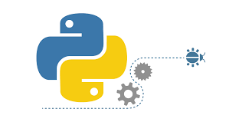

Tools for Data Wrangling

Slide 30
Any Questions ?

Slide 31
Activity
Use Case
Maria is a 25-year-old US Army veteran, newly returned to the civilian workforce. She has recently completed a six-year commitment with the Army. During her time in the Army, she worked in supply management and logistics. She has decided to pursue a degree in Management Systems and Information Technology.
Maria has asked you to use your skill with data to help her search for the best school for her. She is willing to relocate anywhere in the continental United States, but she has a few criteria that her ideal schools must satisfy:
Safety of the city
School should be offering a degree in IT
Ranking of school.
.

Slide 32
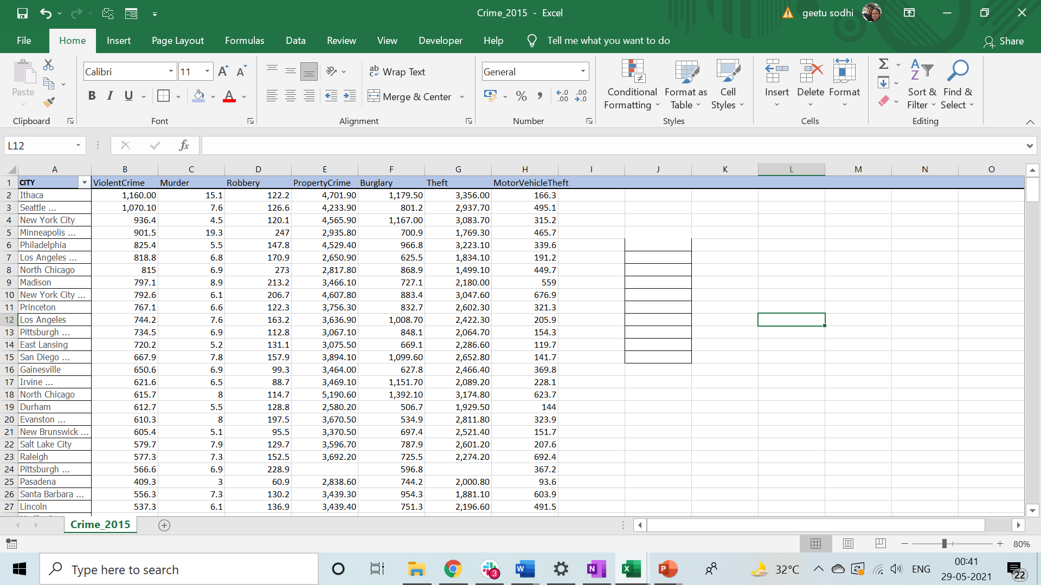
CRIME DATA

Slide 33
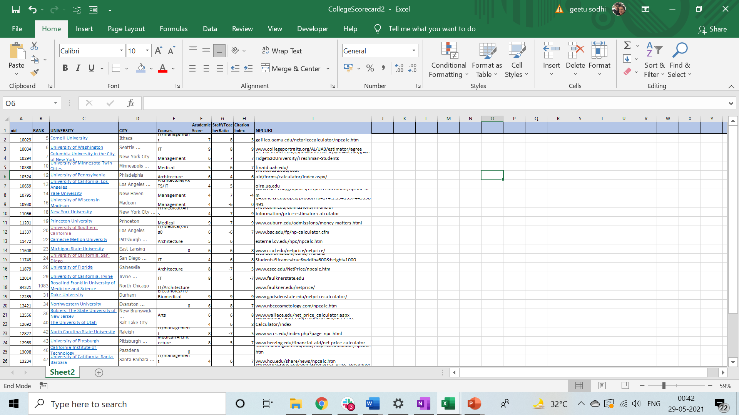
COLLEGE SCORE

Slide 34
Your Task
1)Clean the data:
Remove any duplicates
Missing Values
Inconsistent values
2) Data Enrichment:
Calculate School Ranking
Calculate overall crime rate
.
.
3) Structure the data:
Merge the tables and produce the dataset which must have :
Top 5 schools on rankings for It college
Be in a city that is below 50th percentile in overall crime
Remove unnecessary columns

Slide 35
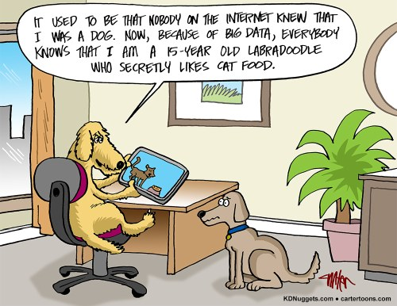

Slide 36
Thank You

